Slide 1
Genene Abebe (PhD)
Research and Community Service
Director
E-mail: gagiabtd@yahoo.com
Phone: +251 911 46 15 26
Action research

Slide 2
Research

Slide 3
Nature and Meaning of Research
The word research itself is derived from the French word “recherché” which means to travel through or to survey.
UNESCO (1962) defined research as “the orderly investigation of a subject matter for the purpose of adding to knowledge”.
Research is also defined as a systematic investigation of a given phenomenon (phenomena) or event (s) by collecting, organizing, analyzing, and interpreting data in order to give solution to a problem or to add to the knowledge already acquired.

Slide 4
  Characteristics of a research
is directed toward the solution of a problem, i.e. it involves the quest for answers to unsolved problems;
is a structured process which follows a systematic order or rule of execution;
is characterized by rigorous logic and objectivity in the carefully designed procedures and analysis;
demands accurate observation and description of phenomena;
involves gathering new data from primary or firsthand sources, or using existing data for new purposes;
involves logical and plausible explanation of the findings of the study;
is replicable;
is expensive in terms of time, money, resources and energy.

Slide 5
  Classifications of a Research
Classification is the act or system of methodically arranging a phenomenon in distinct divisions or classes.
Research studies have been classified in a variety of ways.
Research can be classified as follows:
        Quantitative versus Qualitative Research
        Basic versus Applied Research

Slide 6
Quantitative/Qualitative Research
This is sometimes also referred to as “empirical/positivist vs interpretive/post positivist” paradigm.
Quantitative research, as the name implies, relies mostly on numerical data such as the use of mathematical tools (especially statistics to explain, predict, and/or control phenomena of interest, using the deductive process for data analysis.
The epistemological rationale for the quantitative researcher is that there exists a mind-independent and tangible reality “out there” that is knowable to some extent.
Four types of quantitative research: Descriptive, Correlational, Causal Comparative, and Experimental Research.

Slide 7
Quantitative/Qualitative Research---
Qualitative research, on the other hand, involves the collection of extensive ‘narrative data’ (i.e. non-numerical data) on many variables over a period of time in order to gain insights into phenomena of interest.
Eg:-A case study of employer involvement in TVET delivery at General Wingate Polytechnic College.
Its data analysis includes coding of data and production of a verbal synthesis by the inductive process.
Five main examples of this approach would include historical research, ethnographic research, case study, grounded theory, and phenomenology.

Slide 8
Basic/Applied Research
Basic research, sometimes also called fundamental or pure research, is primarily concerned with the development and advancement/testing of knowledge or theory through verification of hypothesis
e.g. e = mc² of Einstein
It is not particularly concerned with practical application of knowledge to solve everyday problems or to introduce reforms into present practice.
Its rationale is that the purpose of science is to describe and explain the world as it is, and not to change it
Basic research finds its most comfortable niche in a laboratory setting where control of variables can be maximized.

Slide 9
Basic/Applied Research---
In contrast to basic research, applied research is generally concerned with the application of theory to the solution of immediate practical problems.
This may take different forms:
Evaluation Research is the systematic process of gathering data to make decisions of quality and relevance.
e.g. How would a cooperative training affect the employability of TVET graduates in Ethiopia?
Action Research is a unique form of applied research which is focused on solving specific practical problems through the application of the scientific method.
Its value is primarily confined to those conducting it, and its results may not be generalized beyond the sample used for the study.
e.g. What can be done to significantly reduce high failure rate in Drafting Competency Assessment?
Developmental research/ Design research is another form of applied research which is described as a way to establish new procedures, techniques and tools based on specific needs analysis.
It is employed to design and develop an intervention (such as programs, teaching-learning strategies and materials, products and systems).

Slide 10
Action Research

Slide 11
Definition of action research
“Action Research is a disciplined process of inquiry conducted by and for those responsible for taking action . . . to assist them in improving and/or refining their actions.”
It is “The process by which practitioners attempt to study their problems scientifically in order to guide, correct, and evaluate their decisions and actions.” (Stephen Covey)
Action research is a systematic study that combines action and reflection with the intention of improving practice (Ebbutt, 1985)

Slide 12
Definition of action research---
Action research is a methodology which has the dual aims of action and research-action to bring about change and research to increase understanding on the part of the researcher or the client, or both.
It is a process in which participants examine their own practice, systematically and carefully, using the techniques of research.
Action research is also defined as an inquiry or research in the context of focused efforts to improve the quality of a practice.
Action research is usually designed and conducted by practitioners who analyse the data to improve their own practice.

Slide 13
  Who can do action research?
One of the attractions about action research is that everyone can do it, so it is for ‘ordinary’ practitioners as well as trainers, managers, administrators, experts, and others (Steinberg and Kincheloe 1998).
Action research is done by practitioners themselves rather than a professional researcher, who does research on practitioners, as is often the case in traditional forms of social science research.
Social scientists tend to stand outside a situation and ask, ‘What are those people over there doing? How do we understand and explain what they are doing?’ This kind of research is often called spectator research, and is usually outsider research.
Action researchers, however, are insider researchers. They see themselves as part of the situation they are investigating.

Slide 14
Who can do action research?---
Action research is suitable for educators as a practical process because it does not require elaborate statistical analysis (e.g., quantitative research)or lengthy narrative explanations (e.g., qualitative research) but is more concerned with solving a problem in an efficient and feasible manner.
Although traditional research methods are very concerned with generalizability(i.e., applicability of the findings to other settings or populations), action research is more concerned with improvement within the context of the study.

Slide 15
  Why action research?
Action research is a form of self-reflective research carried out by the participants themselves in an educational or social context.
The aim of the research activity is to improve the social or educational practices of the participants and to assist the researchers in deepening their understanding of their own practices and the contexts in which they take place.
Action research is generally conducted:
  To improve practice;
  To solve problem;
  To empower practitioner;
  To explore and test new ideas, methods, and materials;
  As part of continuous professional development.

Slide 16
Action Research (AR) in TVET
TVET is action/practice oriented;
TVET is expected to have more interaction with equipment;
By its nature, TVET requires cross-sectoral engagement and sharing of experiences (PPP)
Studies unveiled that there are practical challenges in the sector which need action

Slide 17
  Characteristics of Action Research
It focuses on immediate application and problem solving, not interested in the development of theory;
It is usually applicable to a particular situation for which the solution has been found (Context-based);
It aims at improving personal or institutional efficiency;
It is cyclic, spiral;
It requires collaboration between researcher and client in order to solve problems.

Slide 18
Comparison of traditional research and action research
What | Traditional research | Action research
Who | Conducted by university professors, scholars, and graduate students | Conducted by teachers, practitioners
Where | In environments where variables can be controlled | In schools/ classrooms/work place
How | To describe relationships | To describe what is happening and to understand the effects of intervention
Why | To report and publish conclusions that can be generalized to larger population | To take action and effect positive change in a specific environment that is studied

Slide 19
Action research as a cyclic process
Action research is cyclic.
  Kemmis and McTaggart (1988) proposed a spiral model for action research comprising four steps:
  planning
  acting
  observing and
  reflecting.

Slide 20
Action research as a cyclic---

Slide 21
Steps in Action Research
Susman (1983) distinguishes five steps to be conducted within each research cycle.
Initially, a problem is identified and data is collected for a more detailed diagnosis.
This is followed by several possible solutions, from which a single plan of action (Action strategy) emerges and is implemented.

Slide 22
Steps---
Data on the results of the intervention are collected and analyzed, and the findings are interpreted in light of how successful the action has been.
At this point, the problem is re-assessed (reflection) and the process begins another cycle. This process continues until the problem is resolved.

Slide 23
Steps ---
1. Identification of starting point
Typically, starting points for research begin with experiences of discrepancies. They can be:
discrepancies between plans and expectations on the one hand and actual practice on the other;
discrepancies between the present situation and a general value orientation or an aim
discrepancies between the way in which different people view one and the same situation.
Action research begins with reflection upon such discrepancies.

Slide 24
Steps---
2. Preliminary Study (Reconnaissance)
Preliminary study is very important to be done to know the real situation of the problem by collecting and analyzing data (pre-intervention data collection and analysis).
The reconnaissance is a situational analysis which produces a broad overview of the action research context, current practices, participants, and concerns.
It focuses on assessing the real situation.

Slide 25
Steps---
To report the effects of the change you need a record of the situation before and after the change.
What were the observations which promoted your concern? What are the current practices and the current situation?

Slide 26
Steps---
3. Literature review
Check literature
To learn more about the topic
to identify solutions

Slide 27
Steps---
4. Developing action strategy
Action strategies are actions which are planned and put into practice by the researcher in order to improve the situation or its context.
Action strategies can be thought of as preliminary answers to the researcher’s questions.
Usually, an action strategy will consist of a number of coordinated actions planned on the basis of the research.

Slide 28
Steps---
The most important source of our action strategy is our new understanding gained from analysis of the situation.
Develop an action plan that includes a method of intervention.
Who is going to do what, and by when? What are the proposed actions to be taken? How do you intend to implement your revised actions?
You also need to make plans for observation or monitoring your proposed changes.

Slide 29
Steps---
5. Intervention (Implementing action strategy)
Put your plan into action to change or bring an improvement in the situation

Slide 30
Steps---
6. Observation (Evaluating result)
Refers to collecting appropriate data, analyzing the data, interpreting it and drawing conclusion for the purpose of checking whether the implementation was successful.
Detailed observation, monitoring and recording enables you to assess the effect of your action or intervention and hence the effectiveness of the proposed change.

Slide 31
Steps---
7. Reflection (Communicating result)
The final step is to reflect on what has been accomplished.
How has the situation changed? Is your problem solved? Have you seen positive results? Do you need more time? Do you need to start over?

Slide 32
Steps---
Reflection is not an end in itself but a means to an end – the end being refined action.
Refined action may include:
  · a new way of doing something;
  · the clarification of an issue;
  · The development of a skill; and
  · The resolution of a problem.

Slide 33
Steps---
8. Plan for subsequent action cycles (Second phase)

Slide 34
Activity
Activity 1:
Imagine that you are interested in examining a specific problem that occurs in your college. For this activity, you need to identify a problem (e.g., girls lose confidence in hard skills), devise a plan (develop an intervention to help increase the self-efficacy of female students in hard skills), implement the plan (conduct the intervention for two quarters), observe the outcome (circulate surveys questioning how the students rate their competency in hard skill), and reflect on the process (note whether the intervention was successful or not, and discuss possible areas of improvement). After writing down the five steps on paper, reflect on the process and how effective you think that action research was.

Slide 35
Components of Action Research report
Title
Name of project, College (Institute), researchers’ name, and date of submission. Identify and limit topic.
Abstract
Keep short and concise discussing the problems, methodology, process, main results and implications

Slide 36
Components---
Introduction
Identify the problem / topic or issue to be studied.
Include in this section: statement of the problem and action research questions, Purpose of the research using literature to justify it, and Describe briefly the background and setting or setting of the study

Slide 37
Introduction
Indicate scope of the focus area;
Provide some background to the topic;
Demonstrate the importance or need for research;
Make a claim (Problematization); Convince your reader that the felt problem really needs study/intervention;
Set clear objectives to address;
Offer an overview/map of the study.

Slide 38
Components ---
Literature Review
  Present a summary of the literature (Articles on journals, books, magazines, news papers, ---) on previous works involving the use of the intervention selected.

Slide 39
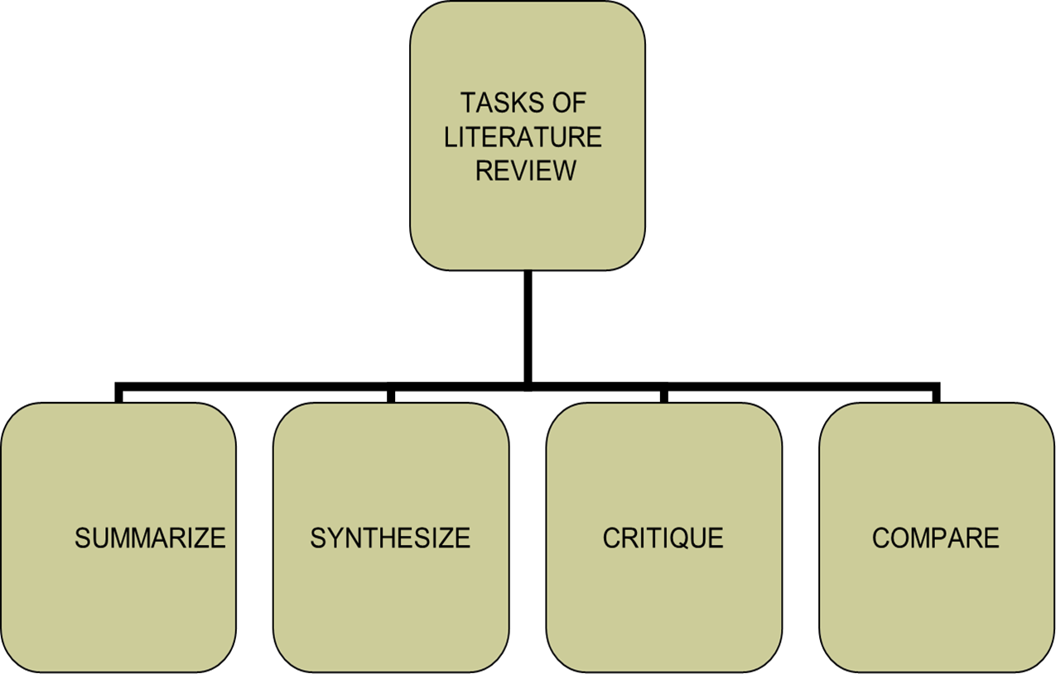
Literature review---

Slide 40
Components---
Methodology:
  Explain how you undertook the research.
  Describe the intervention using literature where possible to support the procedure taken to conduct it.
  State the study’s population and sample as well as the data collection process, analysis and justification.

Slide 41
Procedure of action research data collection techniques
3 Es
Action Research
Data Collection Techniques
(The Three E’s)
Examining
Experiencing
Enquiring
Using and making
records
(Through observation
and field notes)
When the researcher
asks
Archival documents
Participant observation
(Active participant)
Informal Interview
Journals
Structured formal
Interview
Maps
Audio and
Videotapes
Privileged, active
observer
Questionnaires
Attitude Scales
Artifacts
Standardized Tests
Fieldnotes

Slide 42
Analyzing:
Putting It All Together
The data, Empirical evidence, Models, Observable experiences
Then, giving meaning
Not reliant on complex statistical calculations
User-friendly procedures help practitioners systematically identify trends and patterns in action research data

Slide 43
Components ---
Results
This section presents an evaluation of the intervention. What were your findings? Charts, graphs and pictures may be used to enhance this section.
Discussion
Discuss the implications of the findings

Slide 44
Components ---
Summary and Conclusion
Reflect on the finding. State any limitations you encountered, what worked or didn’t and reasons why certain outcomes resulted. Identify any changes you would undertake differently during the next cycle of the intervention and why as well as the impact of the intervention on you personally.

Slide 45
Components---
Implications/Recommendations
Suggest areas for further research on your topic and other recommendations emerging from the study.

Slide 46
Components ---
References
Use the APA form of referencing
Appendices
Include any copies of questionnaires, consent forms, interview and observation schedules in this section.

Slide 47
Activities
Activity 2
Write three action research topics
Activity 3
Write three action research questions

Slide 48
Thank you !!!

